Slide 1
ADVENTURE WORKS
SALES ANALYTICS
End-to-End Data Analytics Project
SALES • DATA • INSIGHTS
PREsented by:
Jatin Kumar

Slide 2
PROJECT OVERVIEW
About the Project
Adventure Works Sales Analytics is a data analytics project focused on analyzing sales performance across products, customers, time periods, and regions.
Project Objectives
• Analyze overall sales performance.
• Calculate Sales Amount, Production Cost, and Profit.
• Identify top-performing products and customers.
• Compare sales across years, months, quarters, and regions.
• Build interactive dashboards for business insights.
Excel
MySQL
Tableau
Power BI

Slide 3
PROJECT WORKFLOW
Data Preparation
Excel
2. Data Modelling & SQL Analysis
MySQL Workbench
3. Dashboard Development
Tableau + Power BI
4. Sales Insights & Reporting

Slide 4
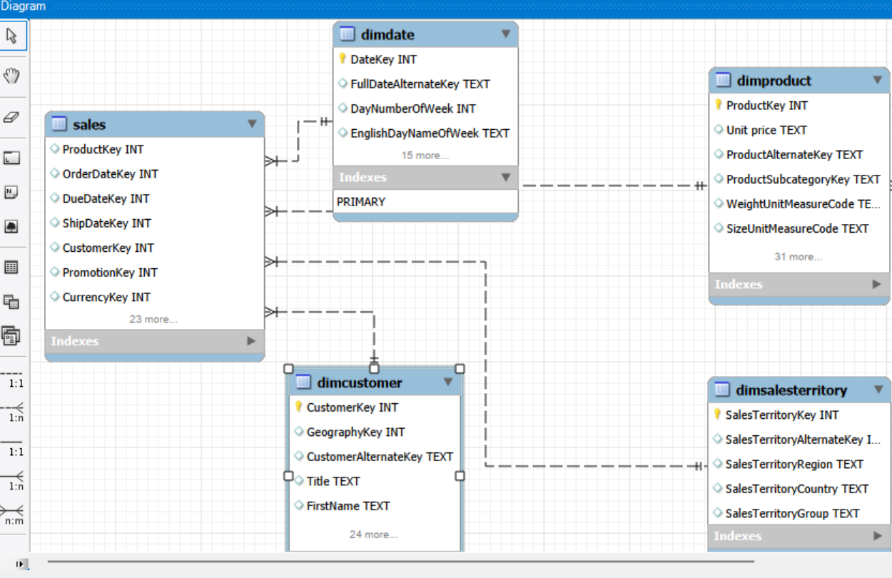
DATA MODEL & RELATIONSHIPS
The SALES table is connected to DimDate, DimCustomer, DimProduct, and DimSalesTerritory. DimProduct is linked to DimProductSubCategory, which is connected to DimProductCategory.

Slide 5

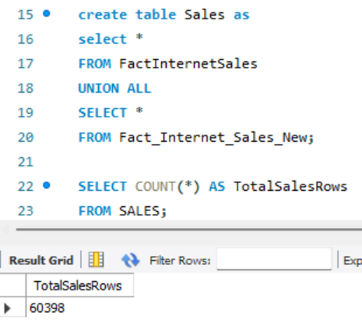



SQL DATA PREPARATION
DATA PREPARATION IN MYSQL
Imported Adventure Works tables into the MySQL database.
Reviewed and prepared the sales and dimension tables.
Combined FactInternetSales and Fact_Internet_Sales_New using UNION ALL.
Created the combined SALES table for further analysis.
Verified a total of 60,398 sales records.

Slide 6

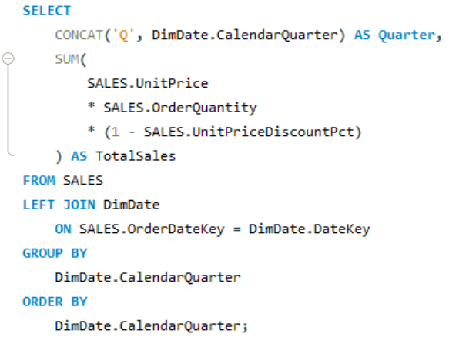
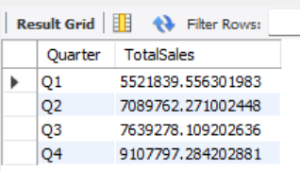
KEY SQL ANALYSIS
ANALYSIS COVERED
Year-wise and month-wise sales analysis
Quarterly sales performance
Production cost and profit calculations
Region-wise sales and top products/customers analysis

Slide 7
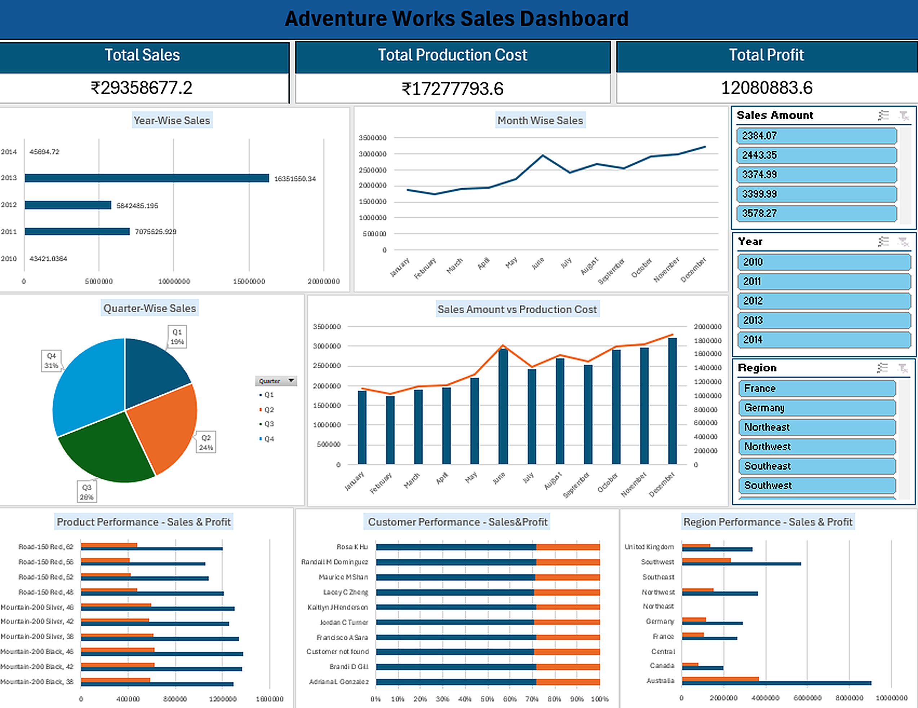
EXCEL SALES DASHBOARD

Slide 8
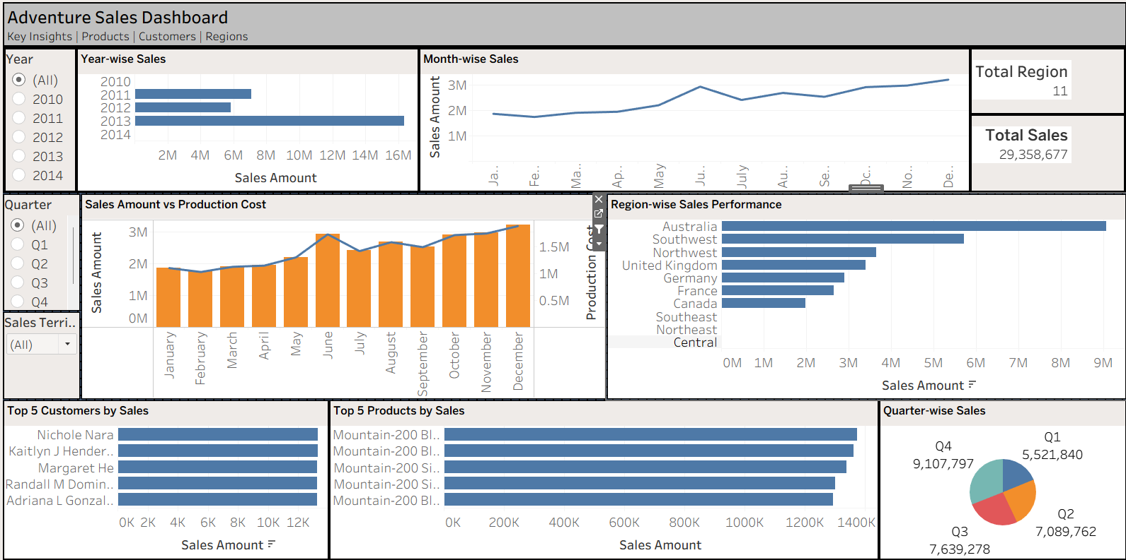
TABLEAU DASHBOARD

Slide 9
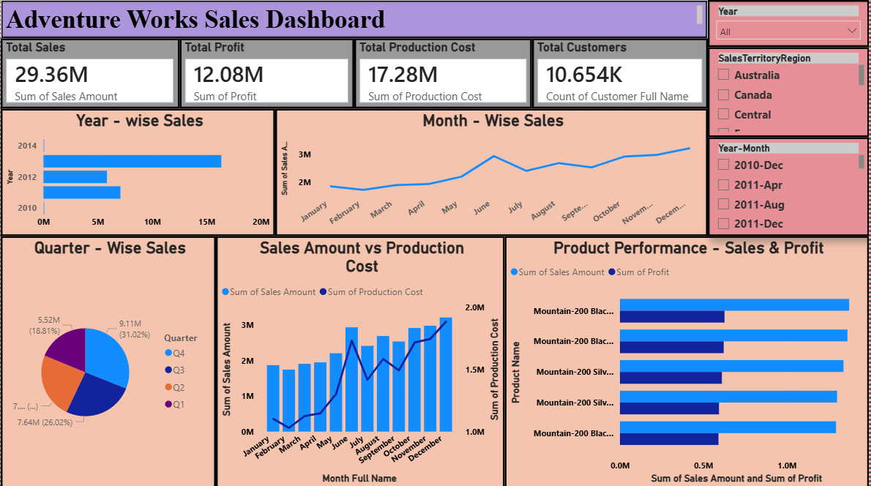
POWER BI DASHBOARD

Slide 10
SALES ANALYSIS SUMMARY
Time-Based Analysis
Analyzed sales by year, month, and quarter.
Profitability Analysis
Calculated Sales Amount, Production Cost, and Profit.
Regional Performance
Compared sales performance across regions.
Dashboard Reporting
Presented sales analysis using Excel, Tableau, and Power BI.

Slide 11
CONCLUSION
This project covered the end-to-end data analytics process using Adventure Works sales data.
Data Preparation: Combined 60,398 sales records using SQL.
Data Analysis: Analyzed sales, production cost, profit, time periods, and regional performance.
Data Visualization: Created dashboards using Excel, Tableau, and Power BI.
Learning Outcome: Gained practical experience in SQL, data analysis, data modeling, and dashboard development.
Overall: This project helped me understand how data analytics tools can transform raw sales data into meaningful business information.

Slide 12
Thank You
Questions & Answers
ADVENTURE WORKS SALES ANALYTICS

